Slide 1
Dual Access Control for Cloud-Based Data Storage and Sharing
Team Details
Neeraj(21eg505837)
Rahul(21eg505841)
Vikas(21eg505866)
Project Supervisor
Mrs. A Durga Bhavani
Assistant Professor

Slide 2
Introduction
Cloud computing provides flexible storage solutions for efficient data sharing among dispersed users, yet concerns over data security hinder widespread adoption. Encryption safeguards data integrity and confidentiality, but evolving data-sharing needs require transforming ciphertext formats. This paper introduces an encryption transformation mechanism integrating Identity-Based Encryption (IBE) and Identity-Based Broadcast Encryption (IBBE), addressing the challenge of securely sharing encrypted data in public cloud environments. Motivated by scenarios like electronic health records sharing, it offers technical solutions for secure data sharing without compromising privacy. Applications include collaborative decision-making in fields like healthcare and finance, where multiple users require access to encrypted data stored in cloud servers, necessitating efficient encryption transformation mechanisms.

Slide 3
Problem Statement
Cloud-based data storage services have become increasingly popular due to their efficient and cost-effective management. However, the open nature of the network raises concerns regarding data confidentiality and user privacy. While encryption is widely employed to protect sensitive data, it alone cannot adequately address the complexities of practical data management needs. Moreover, ensuring effective access control over download requests is essential to prevent Economic Denial of Sustainability (EDoS) attacks that may disrupt service accessibility. This paper aims to tackle the challenge of dual access control within cloud-based storage systems, focusing on both data access and download request management. By designing and analyzing two distinct dual-access control systems, this research seeks to provide comprehensive solutions to secure data management in cloud environments, ensuring both security and efficiency amidst evolving threats and operational demands.

Slide 4
Proposed Method
The proposed method combines a novel identity key verification technique for dual access control with AES 256-bit attribute encryption to bolster security and confidentiality in cloud-based storage systems. Users are assigned unique identity keys for verification, enhancing access control, while documents are encrypted using modified Attribute-Based Encryption (ABE) with AES 256-bit encryption, ensuring robust protection against unauthorized access. This approach not only addresses the limitations of existing CP-ABE schemes but also strengthens data protection measures, safeguarding sensitive information from cryptographic attacks and unauthorized collaboration, thereby enhancing privacy and access control in cloud environments.

Slide 5
Proposed Method
In the proposed method, each user is assigned a unique identity key upon registration in the cloud-based storage system. When a user requests to download a document, they must submit their identity key for verification. The key manager server then validates the identity key against the access attributes associated with the requested document. Simultaneously, the document itself is encrypted using a modified Attribute-Based Encryption (ABE) technique, where unique attribute keys are generated for each document. These attribute keys enable more efficient management of user attributes and facilitate finer-grained access control. Additionally, the encryption process employs AES 256-bit encryption, ensuring robust security and confidentiality of the data. This comprehensive approach enhances security by preventing unauthorized access and collaboration among users, including cloud servers, thereby bolstering privacy protection and access control in cloud-based storage systems.

Slide 6
Experiment Environment
Tools
My SQL
Apache Tomcat
Language
JAVA
Frontend:
HTML
CSS
JAVASCRIPT

Slide 7
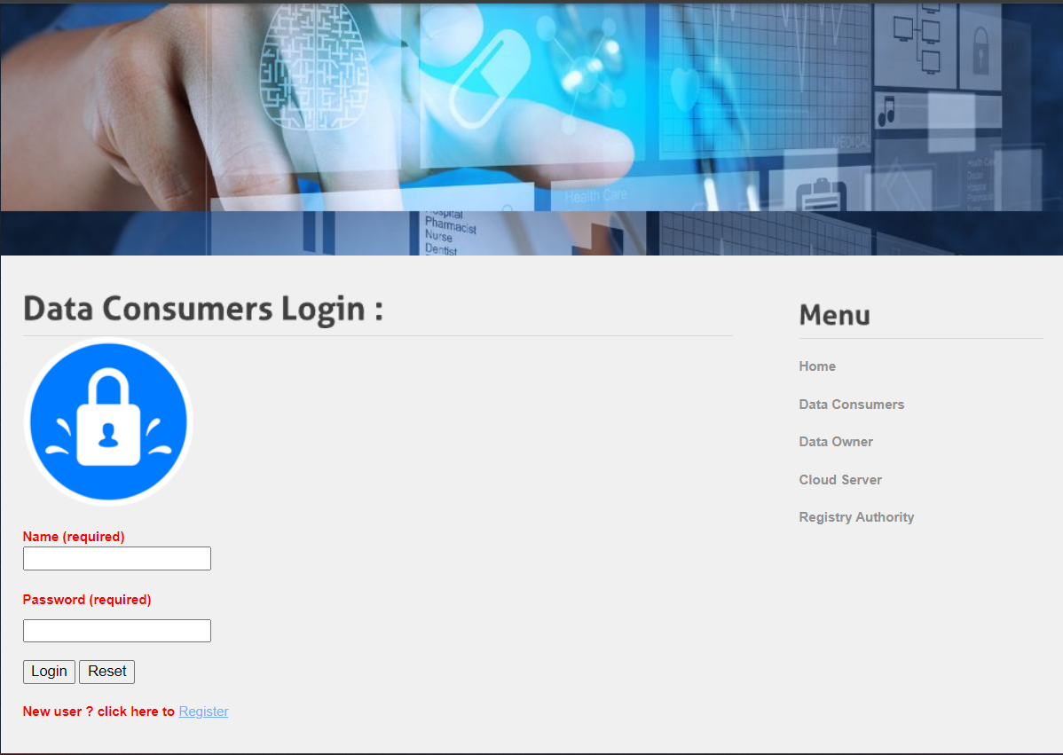
Experiment Screenshots
Data Consumer Login

Slide 8
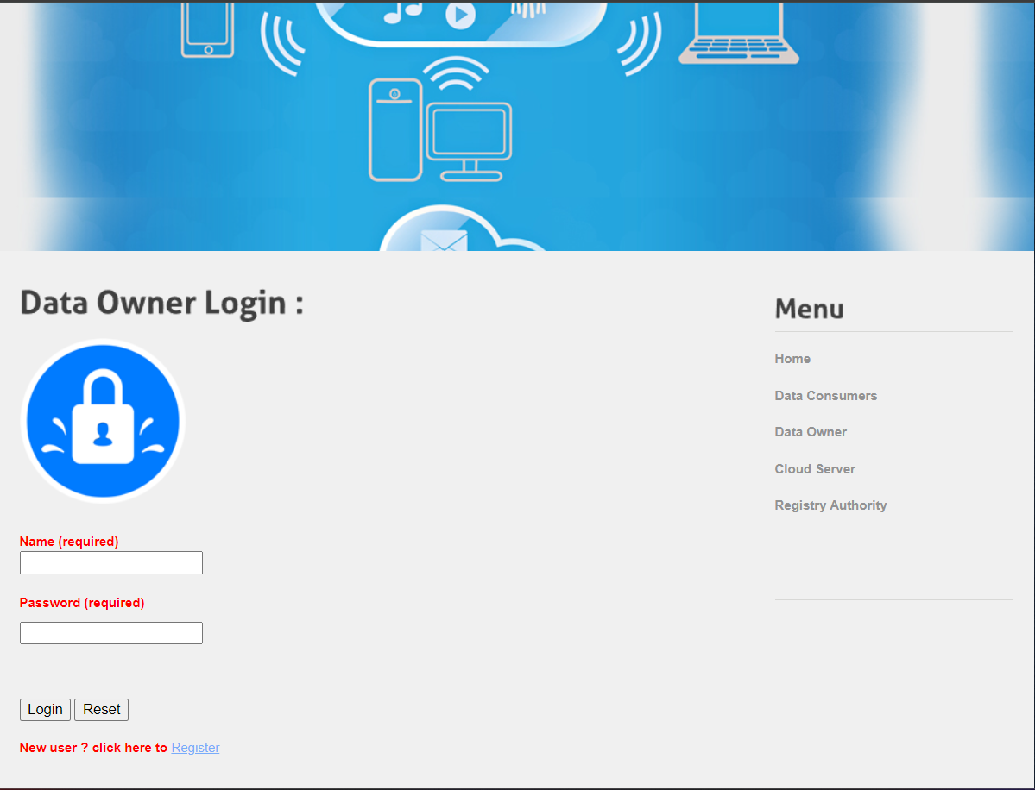
Experiment Screenshot
Data Owner Login

Slide 9

Experiment Screenshot
Cloud Login

Slide 10
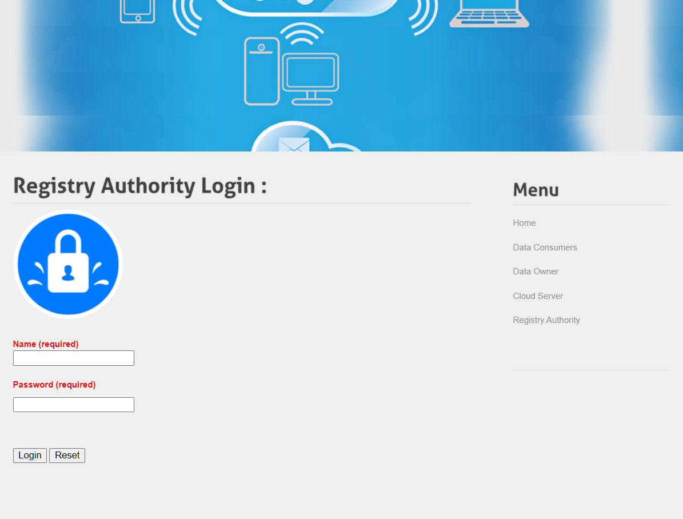
Experiment Screenshot
Registry Authority Login

Slide 11
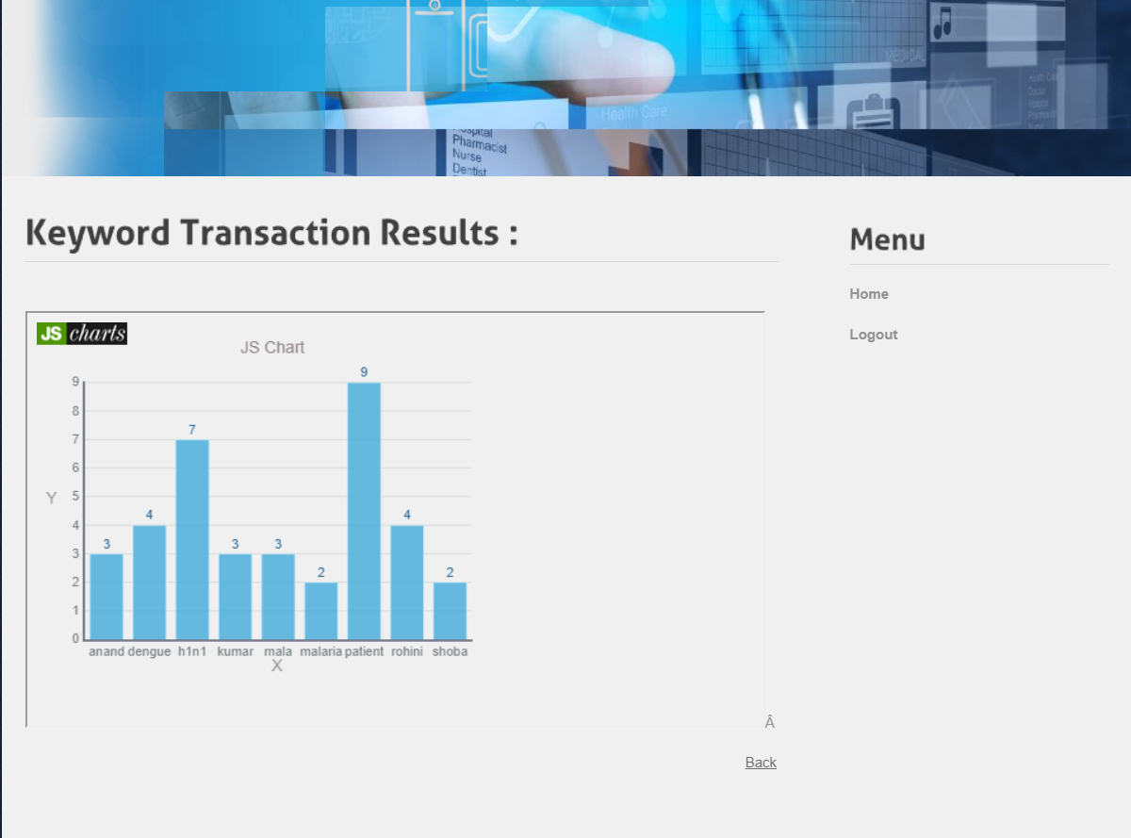
Experiment Results
Keyword Transaction Result

Slide 12

Experiment Results
Patient Report Details

Slide 13
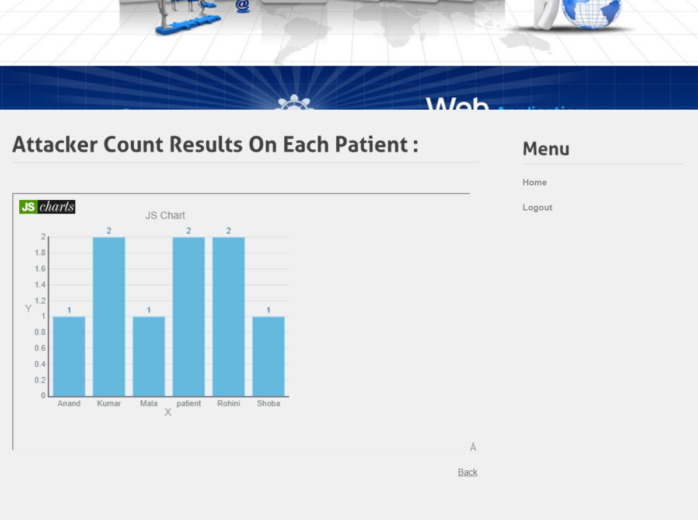
Experiment Results
Attacker Count Results

Slide 14
Finding
The project demonstrates the efficacy of integrating a novel identity key verification technique with AES 256-bit attribute encryption and modified Attribute-Based Encryption (ABE) in cloud-based storage systems. This approach enhances access control by assigning unique identity keys to users and generating attribute keys for documents, ensuring robust security and confidentiality. The implementation of AES 256-bit encryption further fortifies data protection measures, effectively safeguarding sensitive information from unauthorized access and collaboration. Overall, the project findings highlight the importance of comprehensive security measures in cloud storage environments, contributing to enhanced privacy protection and access control.

Slide 15
Justification
Enhanced Access Control: The proposed method introduces a novel identity key verification technique and modified Attribute-Based Encryption (ABE), improving access control parameters. Users are assigned unique identity keys, and documents are encrypted with attribute keys, leading to finer-grained access control over data. This enhances security by ensuring that only authorized users with matching access attributes can access specific documents, thereby mitigating the risk of unauthorized access and data breaches.
Strengthened Data Confidentiality: The utilization of AES 256-bit attribute encryption strengthens data confidentiality parameters. By employing robust encryption mechanisms, sensitive information stored in the cloud-based storage system is safeguarded against cryptographic attacks and unauthorized access attempts. This enhances data confidentiality, ensuring that only authorized users with valid decryption keys can access and decrypt the encrypted data.
Improved Security Measures: Overall, the proposed method enhances security parameters by combining identity key verification, modified ABE, and AES 256-bit encryption. These measures collectively reinforce security in cloud-based storage systems by preventing unauthorized access, ensuring data confidentiality, and enabling efficient access control mechanisms. By addressing the limitations of existing systems and implementing comprehensive security measures, the proposed method offers improved privacy protection and access control in cloud environments.

